Slide 1
Higher Biology
Food Supply, Plant Growth and Productivity
Mr G R Davidson

Slide 2
Food Security
The human population continues to grow and food security is a very important issue for its survival.
Food security is the ability to access food of sufficient quality and in sufficient quantity over a sustained amount of time.

Slide 3
Food Security
Food security depends on a number of factors:
The availability of food
Knowledge of nutrition to make good use of the food
Sufficient economy to access the food resources
Sustainability of the food supply over a period of time

Slide 4
Food Security
Food production can be affected by a number of factors:
Disease
Flood
Pests
Drought
Insecticide resistance

Slide 5
Food Security
It is important that increasing plant productivity doesn’t affect the environment in ways like:
Deforestation
Erosion
Global warming
Reducing soil fertility
Pollution

Slide 6
Agriculture
There are a huge number of edible plants on Earth but we only make use of a very small number of these for most of our food supply.
It is important that when we grow these plants that we improve the efficiency of the production.

Slide 7
Agriculture

Slide 8
Agriculture
We can improve production by controlling a number of factors.
There are those factors which can limit photosynthetic rate:
Light intensity
Temperature
CO₂ concentration
Nutrients available
Competition

Slide 9
Agriculture
There are also other factors which we can try to control such as:
Drainage
Pest resistance
Disease
Soil type

Slide 10
Energy Loss
As we move along a food chain, energy is lost at each level.
It stands to reason, therefore, that consuming plants provides the greatest amount of energy.
There are, however, areas where crop plants can’t grow but farm animals can live, but much less food is produced per unit of area by farming animals.

Slide 11
Photosynthesis
Green plants trap sunlight energy to produce food by a process called photosynthesis.
This light energy travels in waves to the leaves where some will be:
Absorbed for photosynthesis
Reflected back off the leaf surface
Transmitted through the leaf

Slide 12
Photosynthesis
Light
reflected
O₂ released
CO₂ from
the air
Light
absorbed
Glucose made
by photosynthesis
Water from
the soil
Light
transmitted

Slide 13
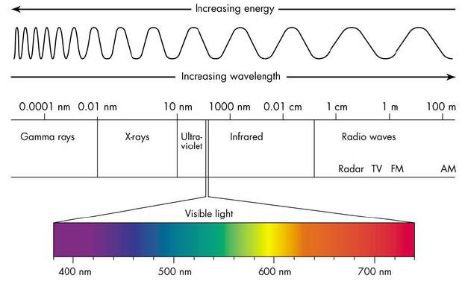
Photosynthesis
If we pass visible light through a prism a spectrum is produced because we see all the different wavelengths of light.

Slide 14
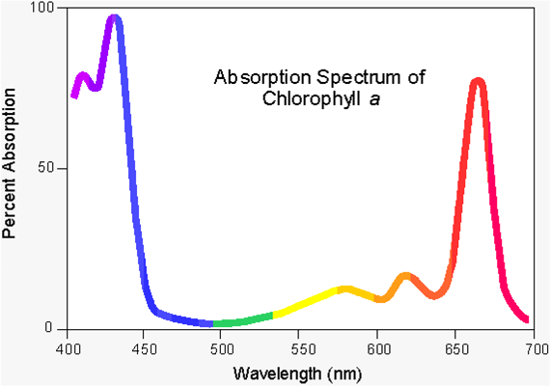
Photosynthesis

Slide 15
Photosynthesis
Green leaves have a variety of pigments in them which are capable of absorbing this light energy.
Each pigment absorbs light of a particular wavelength.
An absorption spectrum is a graph produced to represent the ability of these pigments to absorb different wavelengths of light.

Slide 16
Photosynthesis
There are a number of pigments in plant leaves, depending on where the plant lives.
The more pigments it has, the greater the range of wavelengths of light it is able to absorb.

Slide 17
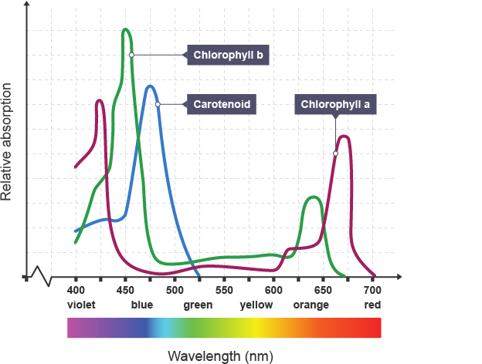
Photosynthesis

Slide 18
Photosynthesis
The rate of photosynthesis at different wavelengths of light is shown on a graph called an action spectrum.
The absorption spectrum and the action spectrum are similar in shape which indicates that it is the pigments which are providing the energy for photosynthesis to occur.

Slide 19
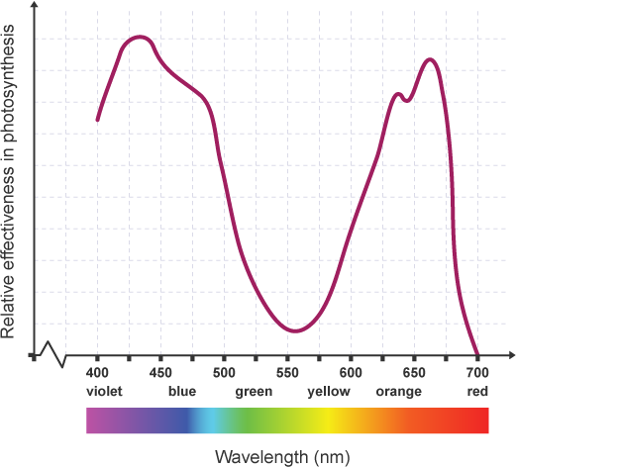
Photosynthesis

Slide 20
Photosynthesis
We can separate the leaf pigments using a process called thin-layer chromatography.
This involves extracting the pigments from the leaf by grinding the leaf up in acetone.
This extract is then repeatedly spotted onto a thin layer strip to create a concentrated spot of pigments.

Slide 21
Photosynthesis
The strip is then placed in a container with the spot of pigments above the solvent level.
As the solvent rises up the strip, the pigments are separated depending on how soluble they are.
The more soluble, the further up the strip they will travel.

Slide 22
Thin-Layer Chromatogram
Solvent front
Carotene
Chlorophyll a
Chlorophyll b
Xanthophyll
Concentrated spot of pigments
Line of origin

Slide 23
Energy Capture
When sunlight energy is absorbed by photosynthetic pigments electrons in the pigment become excited.
These electrons are then carried through a series of carrier molecules attached to the chloroplast’s membrane.

Slide 24
Energy Capture
Here, they release their energy to ATP synthase which will generate ATP from ADP + Pi.
Some of this energy is also used in a process called photolysis which is the splitting of water into hydrogen which binds to a hydrogen acceptor called NADP to NADPH, and oxygen which is released as a waste product.

Slide 25
Energy Capture
The NADPH is then used in the next stage of photosynthesis, called the Calvin Cycle (or Carbon Fixation).
Photolysis (sometimes called the light reaction) occurs in the grana (singular granum) of the chloroplasts.
The production of ATP by photolysis is called photophosphorylation.

Slide 26
Energy Capture
pigment
ATP synthase
High energy electrons
Oxygen
Electron carriers
water
ADP + Pi
ATP
NADP
NADPH
Calvin Cycle

Slide 27
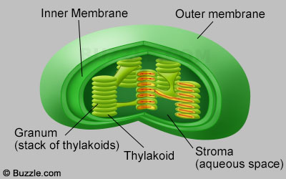
Chloroplast

Slide 28
Calvin Cycle
The Calvin Cycle takes place in the stroma of the chloroplast.
Here, the NADPH and ATP from photolysis are used to build carbohydrates.
This stage does not require light but is a series of enzyme controlled reaction which form a cycle.

Slide 29
Calvin Cycle
Carbon dioxide from the air becomes attached to RuBP (ribulose biphosphate) by an enzyme called rubisco (ribulose biphosphate carboxylase/oxygenase).
This forms an intermediate molecule, 3-phosphoglycerate (3PG), which is combined with the hydrogen from the NADPH.

Slide 30
Calvin Cycle
This is then phosphorylated by ATP to produce glyceraldehyde-3-phosphate (G3P).
Some of this G3P is used to regenerate RuBP while the rest is used to synthesise glucose.

Slide 31
Calvin Cycle
This glucose can then be used for a number of things such as:
Built into structural carbohydrates such as cellulose.
Stored as starch.
Cellular respiration to provide energy.
Other carbohydrates can be used to make a variety of metabolites such as proteins and lipids.

Slide 32
Plant Productivity
Plant productivity is the rate of production of biomass.
The net assimilation is the overall increase in biomass of plants.
It is the gain made by photosynthesising minus the loss used by respiration.
Net assimilation is measured as the increase in dry mass per unit area of leaf per unit of time.

Slide 33
Plant Productivity
The biological yield is the total biomass produced.
The economic yield is the mass of the desired product.
The harvest index is equal to the dry mass of the economic yield / dry mass of the biological yield.

